Slide 1

IT 353 Web Development Technologies
Jianwei Lai
jlai12@ilstu.edu

Slide 2
What is jQuery?
jQuery is a fast, small, and feature-rich JavaScript library.
The purpose of jQuery is to make it much easier to use JavaScript on your website.
jQuery takes a lot of common tasks that require many lines of JavaScript code to accomplish, and wraps them into methods that you can call with a single line of code.
jQuery also simplifies a lot of the complicated things from JavaScript, like AJAX calls and DOM manipulation.
An example: https://www.w3schools.com/jquery/tryit.asp?filename=tryjquery_click

Slide 3
Downloading jQuery
Production version - this is for your live website because it has been minified and compressed
Development version - this is for testing and development (uncompressed and readable code)
https://jquery.com/download/

Slide 4
jQuery CDN
If you don't want to download and host jQuery yourself, you can include it from a CDN (Content Delivery Network)
<head> <script src="https://ajax.googleapis.com/ajax/libs/jquery/3.5.1/jquery.min.js"></script> </head>
Notes:
One big advantage of using the hosted jQuery from Google: Many users already have downloaded jQuery from Google when visiting another site. As a result, it will be loaded from cache when they visit your site, which leads to faster loading time. Also, most CDN's will make sure that once a user requests a file from it, it will be served from the server closest to them, which also leads to faster loading time.

Slide 5
jQuery Syntax
Basic syntax is: $(selector).action()
A $ sign to define/access jQuery
A (selector) to "query (or find)" HTML elements
A jQuery action() to be performed on the element(s)
Examples:
$(this).hide() - hides the current element.
$("p").hide() - hides all <p> elements.
$(".test").hide() - hides all elements with class="test".
$("#test").hide() - hides the element with id="test".

Slide 6
The Document Ready Event
$(document).ready(function(){ // jQuery methods go here... });
$(function(){ // jQuery methods go here... });
This is to prevent any jQuery code from running before the document is finished loading (is ready).
Notes:
In the zombie project
….
<body onload="docReady()"> <!-- a web page has completely loaded all content (e.g., images, CSS files...). for example. a video needs to be loaded-->
<h1 id = "message">This is a scary zombie</h1>
<div id ="zombie" style="position:absolute; left:50px; top:50px"; ></div> <!-- initial position of the zombie-->
</body>
</html>
Try remove the “docReady()” function use the following instead
$(document).ready(function(){
window.addEventListener('keydown', moveZombie);
/*eventListner can tell a key is pressed, and then call the function moveZombie*/
});

Slide 7
Examples
DOM Traversal and Manipulation
$( "button.continue" ).html( "Next Step..." )
Event Handling
$(document).ready(function(){
$("button").click(function(){
$("p").hide(1000);
});
});
Try the example here:
https://www.w3schools.com/jquery/tryit.asp?filename=tryjquery_hide_slow
Notes:
Get rid of 1000
How to change the button to “show”?
$("button").html("show");

Slide 8
jQuery Selectors
All selectors in jQuery start with the dollar sign and parentheses: $().
jQuery selectors are used to "find" (or select) HTML elements based on their name, id, classes, types, attributes, values of attributes and much more.
It's based on the existing CSS Selectors, and in addition, it has some own custom selectors.
$(document).ready(function(){ $("button").click(function(){ $("#test").hide(); }); });
$(document).ready(function(){ $("button").click(function(){ $("p").hide(); }); });

Slide 9
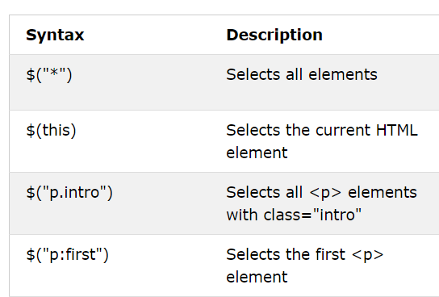
jQuery Selectors
https://www.w3schools.com/jquery/jquery_selectors.asp
Notes:
<!DOCTYPE html>
<html>
<head>
<script src="https://ajax.googleapis.com/ajax/libs/jquery/3.5.1/jquery.min.js"></script>
<script>
$(document).ready(function(){
$("button").click(function(){
$(this).hide(1000);
});
});
</script>
</head>
<body>
<button>Hide</button>
<p id="test">This is a paragraph with little content.</p>
<p>This is another small paragraph.</p>
</body>
</html>
<!DOCTYPE html>
<html>
<head>
<script src="https://ajax.googleapis.com/ajax/libs/jquery/3.5.1/jquery.min.js"></script>
<script>
$(document).ready(function(){
$("button").click(function(){
$("p.intro").hide(1000);
});
});
</script>
</head>
<body>
<button>Hide</button>
<p class="intro">This is a paragraph with little content.</p>
<p>This is another small paragraph.</p>
</body>
</html>

Slide 10
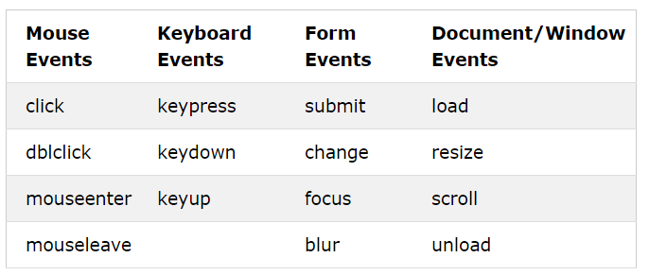
jQuery Event Methods

Slide 11
Try with mouseenter and mouseleave
<style type="text/css">
p{
padding: 20px;
font: 20px sans-serif;
background: #f2f2f2;
}
p.highlight{
background: yellow;
}
</style>
<script type="text/javascript">
$(document).ready(function(){
$("p").mouseenter(function(){
$(this).addClass("highlight");
});
});
</script>
How to remove highlight when the mouse leaves?
Notes:
<style type="text/css">
p{
padding: 20px;
font: 20px sans-serif;
background: #f2f2f2;
}
p.highlight{
background: yellow;
}
</style>
<script type="text/javascript">
$(document).ready(function(){
$("p").mouseenter(function(){
$(this).addClass("highlight");
});
$("p").mouseleave(function(){
$(this).removeClass("highlight");
});
});
</script>

Slide 12
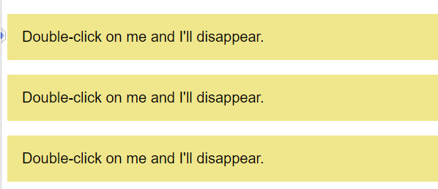
Try with dblclick
<script >
$(document).ready(function(){
//double click to disappear
});
</script>
Notes:
<script>
$(document).ready(function(){
$("p").dblclick(function(){
$(this).slideUp();
});
});
</script>

Slide 13
How to switch between hide and show?
https://www.w3schools.com/jquery/tryit.asp?filename=tryjquery_hide_slow
Try with:
$("button").html("<b>Show</b>");
$("button").text("<b>Show</b>");
Notes:
<script>
$(document).ready(function(){
$("button").click(function(){
var txt = $("button").text();
if (txt === "Hide"){
$("p").hide(1000);
$("button").html("<b>Show</b>");
} else {
$("button").html("<b>Hide</b>");
$("p").show();
}
});
});
</script>
.text treat tags as texts

Slide 14
An easier Way to Hide/Show: Toggle
https://www.w3schools.com/jquery/tryit.asp?filename=tryjquery_toggle
How to change the text on the button?
Return text content:
text()
Set text content:
$(selector).text(content)
Notes:
<script>
$(document).ready(function(){
$("button").click(function(){
$("p").toggle();
$(this).text(function(i, text){
return text == "Show" ? "Hide" : "Show";
});
});
});
</script>

Slide 15
$("button").click(function(){
$(this).text($(this).text() == 'Show' ? 'Close' : 'Show');
});
https://www.w3schools.com/jquery/tryit.asp?filename=tryjquery_toggle
Notes:
var txt = $(this).text();
var x = txt == 'Show' ? 'Close' : 'Show';
$(this).text(x);

Slide 16
function
Type: Function( Integer index, String text ) => String
A function returning the text content to set. Receives the index position of the element in the set and the old text value as arguments.
$(this).text(function(i, text){
return text == "Show" ? "Hide" : "Show";
});
https://www.w3schools.com/jquery/tryit.asp?filename=tryjquery_html_text_func
Notes:
<script>
$(document).ready(function(){
$("button").click(function(){
$("p").toggle();
$(this).text(function(i, text){
return text == "Show" ? "Hide" : "Show";
});
});
});
</script>
add two variables to the function to see the index and content. Variable names do not have to be i and text
<script>
$(document).ready(function(){
$("button").click(function(x, y){
$("p").text(function(e, tx){
return "This p element has index: " +e + tx;
});
});
});
</script>

Slide 17
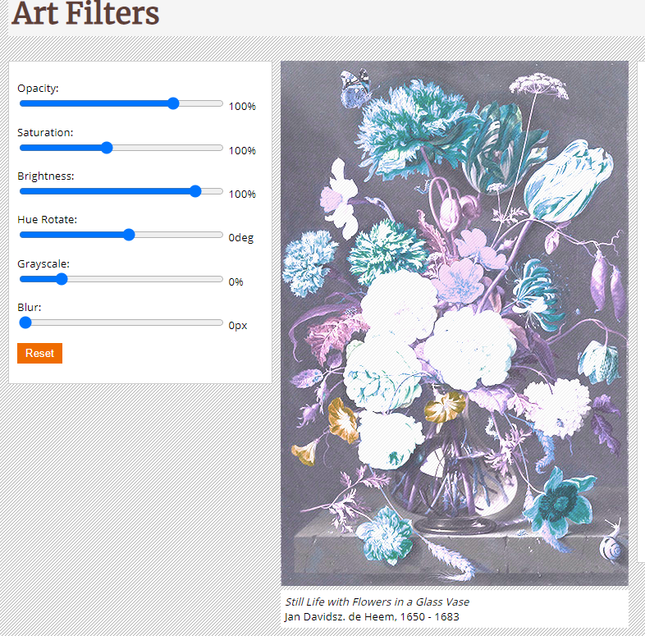
In-class practice 3
Download the zip file in week 6 folder
Add jQuery code in the “filter” script file to make the filters work

Slide 18
Step 1: Add Document Ready Function
$(document).ready(function(){
});
Notes:
It is also fine to use
$(function() {
});

Slide 19
Step 2: refer to all sliders
$("input[type=range]") to refer to all sliders
<input type="range" id="sliderOpacity" min="0" max="100" value="100" class="sliders" />
<input type="range" id="sliderSaturation" min="1" max="300" value="100" class="sliders"/>
<input type="range" id="sliderBrightness" min="0" max="300" value="100" class="sliders" />
<input type="range" id="sliderHue" min="0" max="360" value="0" class="sliders" />
<input type="range" id="sliderGray" min="0" max="100" value="0" class="sliders"/>
<input type="range" id="sliderBlur" min="0" max="10" value="0" class="sliders" />

Slide 20
Step 3: get value when input sliders are moved
$("input[type=range]").on('input',function( ) {
}
);
.on()
Attach an event handler function for one or more events to the selected elements.
https://api.jquery.com/category/events/
Notes:
The following two methods of clicking work the same
<script>
$(document).ready(function(){
$("p").click(function(){
$(this).hide();
});
});
</script>
<script>
$(document).ready(function(){
$("p").on('click', function(){
$(this).hide();
});
});
</script>

Slide 21
Store values into variables
$("input[type=range]").on('input',function( ) {
var opacity = $('#sliderOpacity').val();
var saturation = $('#sliderSaturation').val();
var brightness = $('#sliderBrightness').val();
var hue = $('#sliderHue').val();
var blur = $('#sliderBlur').val();
var gray = $('#sliderGray').val();
}
);

Slide 22
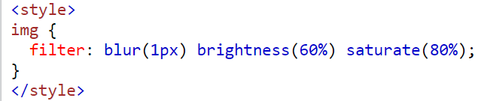
Step 4: put the filter values into a variable
An example of how to use filter to an image in css
Create a similar filter string and put it into a variable called settings
var settings = 'blur(' + blur + 'px) ' +
'brightness(' + brightness + '%) ' +
'saturate(' + saturation + '%) ' +
'hue-rotate(' + hue + 'deg) ' +
'grayscale(' + gray + '%) ' +
'opacity(' + opacity + '%) ';

Slide 23
Step 5: refer to the picture to be filtered
var bigImage = $('#imgManipulated img');

Slide 24
Step 6: change the css of the picture with css()
bigImage.css('filter', settings);
Check the jQuery .css() method here
https://www.w3schools.com/jquery/jquery_css.asp

Slide 25
Zip the project folder and submit it to Reggienet by 9/29
Try the sliders to see how the pictures is changed

Slide 26
Assignment 2 is due tonight

